Slide 1
The Advancement of Mars Colonization Through Agricultural Development
Michael Bustamante, Julio Enriquez, Aaron Torres, Andrew Cline, Moises Nunez, Ignasio Hernandez, Jordyn Stanek, Sky Hoffert, Trung Le
Research Mentor: Dr. Jeffrey Martz

Slide 2
NASA Core Competencies
The project will be based on NASA’s core competencies:
Power
Autonomy
Low Mass
Durability
Simplicity

Slide 3

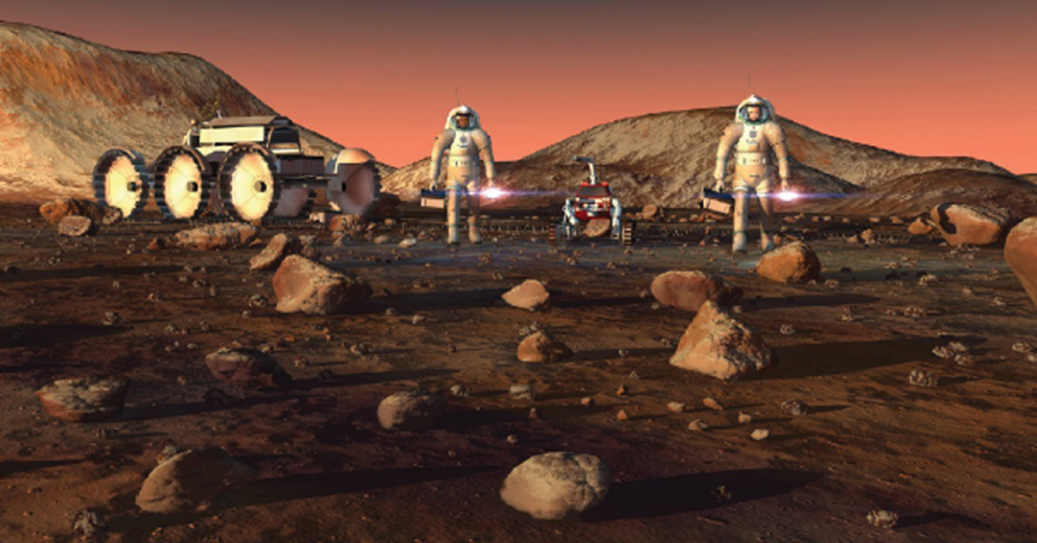
Design Challenge Goal
How would humans use bioinspired resource extraction to live on mars?

Slide 4
Research Goal
To maintain an Earth-independent colony by developing agricultural techniques that can be used to extract, refine, and store essential resources.
These agricultural techniques will be applied to different plant species to extract the highest quantities of food, oxygen, and biofuels.
To model this theoretical design the team will be building a prototype that will mimic the Mars soil environment.

Slide 5
Project Overview
Major Deliverables | Project Components
Prototype | Resources | 2) Extraction | 3) Refinement | 4) Storage
Theoretical Model | -Oxygen -Carbon dioxide -Hydrogen -Food -Biofuels -Nitrogen -natural gas | -Plants -source of Nitrogen -Combination of carbon dioxide and hydrogen | -Refinement of biofuels | -Gas tanks -Fuel Tanks
 | -Sun -Nuclear Isotope -Chemical energy -Perchlorates -Water | -Absorption of heat -Battery technology -Excavation of Martian soil | -Distillation of water -Purification of Martian soil to extract perchlorates | -Nuclear Reactor -Batteries -Water reservoir -Fuel tanks

Slide 6
Design Challenge Project Overview (cont.)
Our project will be divided into four disciplinary areas:
Chemistry
Geology
Computation
Electrical Engineering

Slide 7
Prototype Design
The prototype will gather tangible data to determine the most effective plant soil compositions, growth medium, essential nutrient levels, and sensor data management.
Characterization methods such as biomass measurements, soil composition measurements and statistical analysis will be used to gather quantifiable data from the prototype.

Slide 8
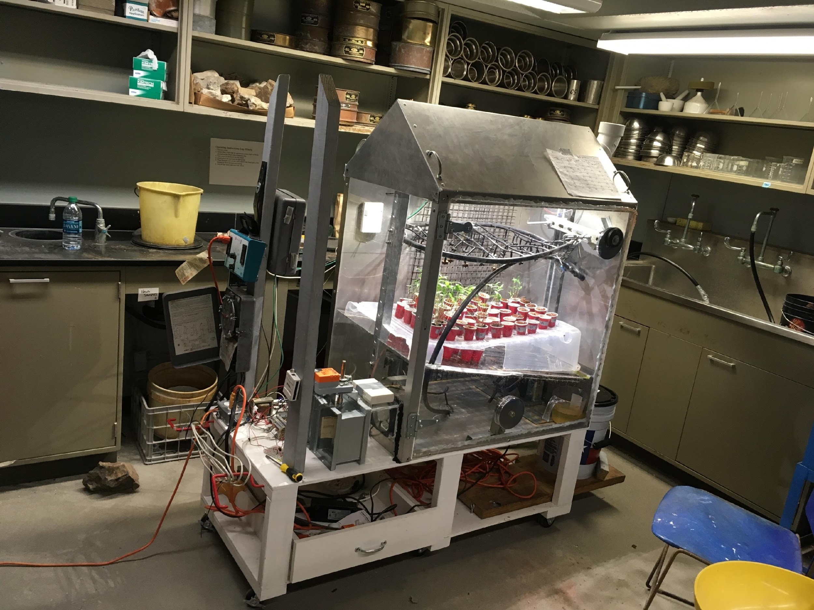
Prototype Design

Slide 9
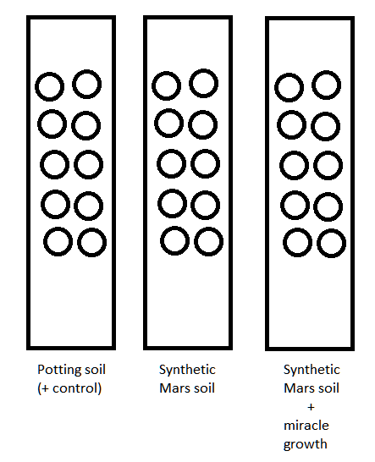
Growth environment experiment
Experiments are being done to determine:
Ideal composition of the soil being used
Ideal watering interval and volume
Ideal light cycle using artificial light
50 pots of mung bean will be planted in soil, another 50 pots will planted in basaltic rock using a hydroponic system
The final biomass will be dried and weighted

Slide 10
Growth environment
Current environmental factors that we are monitoring:
Soil: Potting soil is used as positive control. Synthetic Mars soil and Synthetic Mars soil + Miracle Growth is being tested.
Temperature: 20ºC +/- 3ºC
Humidity: 65% +/- 15%
Light interval: 16 hours
Watering interval: twice per day
The water run off from the pots is collected and reused.

Slide 11
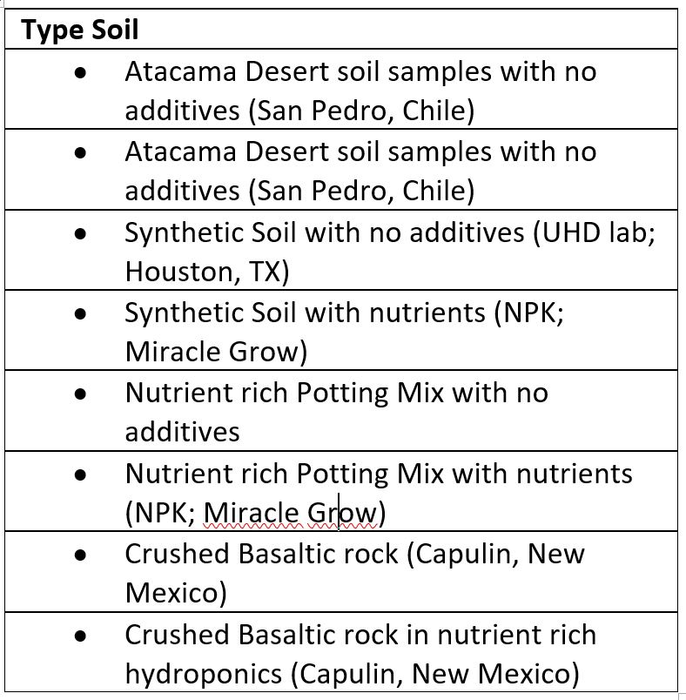
Integration of Geologic Studies
Development of experimental soil samples:
Ratios of essential nutrients and organic compounds
Types of soil samples that mimic Mars soil
Growing patterns (Soil and Hydroponic)

Slide 12
Theoretical Design
The experimental data obtained by the prototype will be used to develop a theoretical Mars’ colonization model, that will sustain a population of individuals located in the Martian environment for an extended period of time.
This period could be extended or shortened depending on the needs of the crew in Mars.

Slide 13
Theoretical Design Components
The theoretical design will be composed of:
Power sources
Materials used to house the vegetation
Biological and geological characteristics of the growth environment
Extraction, refinement, use or storage processes for the targeted essential resources

Slide 14
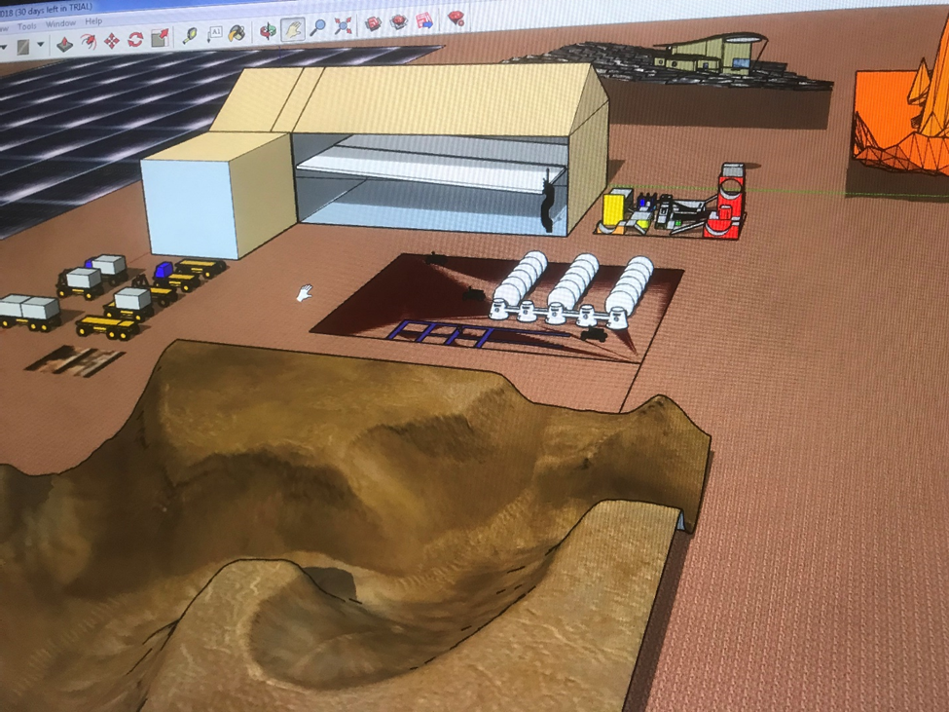
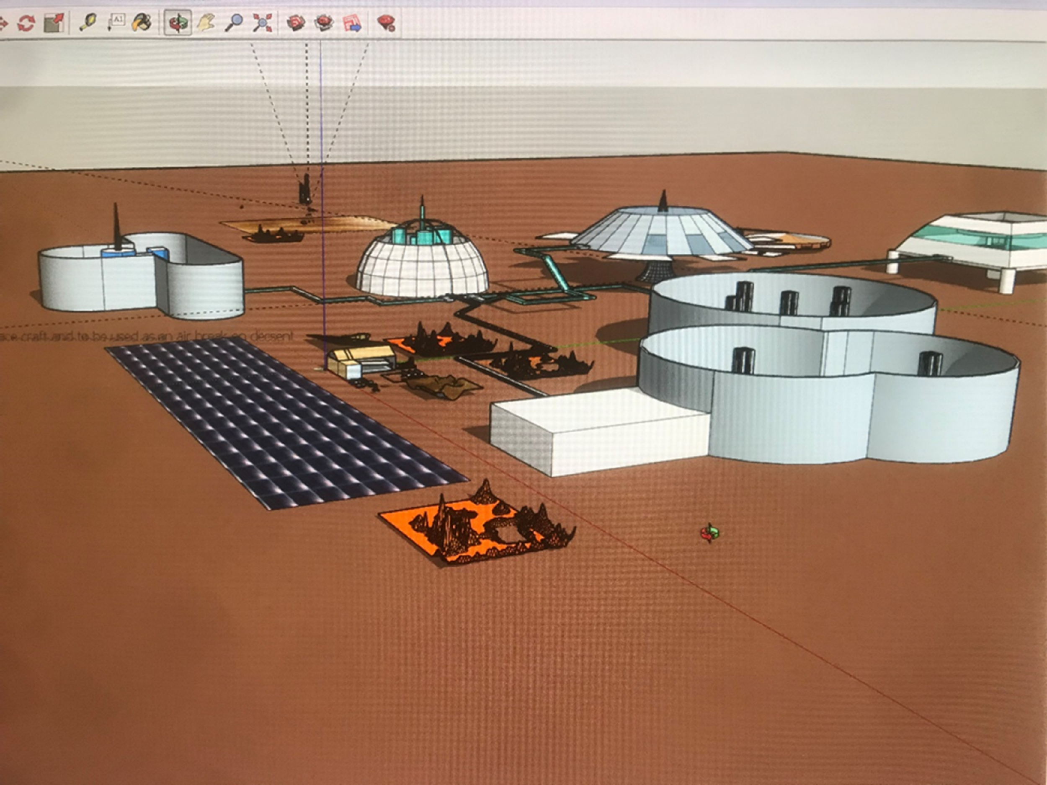
Theoretical Computer Model

Slide 15

Power Resources and Automation
Sustaining an Artificial Environment

Slide 16
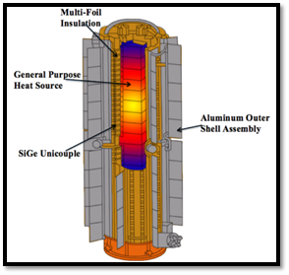
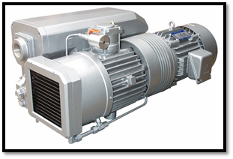
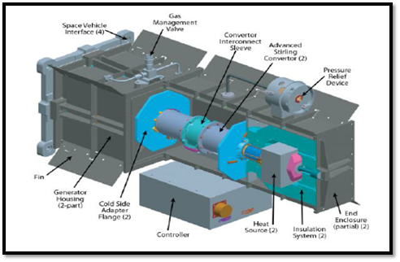
Air Cooled MMRTG
adminSafikulIslamsafikulislamwb@gmail.comAdministratorNewsforShopping. “Dry Vane Vacuum Pump: Range of Applications for Various Industries.” NewsforShopping, 22 Dec. 2017, newsforshopping.com/products-reviews/dry-vane-vacuum-pump-range-applications-various-industries/.
Lou Qualls, A & Schmitz, Paul & Rusick, Jeffrey & F. Zakrajsek, June & F. Woerner, Dave & Cairns-Gallimore, Dirk. (2017). Dynamic Radioisotope Power System development for space exploration. 1-7. 10.1109/AERO.2017.7943892.
“Application of Silicon-Germanium Thermoelectrics in Space Exploration.” Wikiwand, www.wikiwand.com/en/Application_of_silicon germanium_thermoelectrics_in_space_exploration
Martian Air Vacuum
Main Idea
Heat Source
There will be air channels that are not in contact with the core

Slide 17
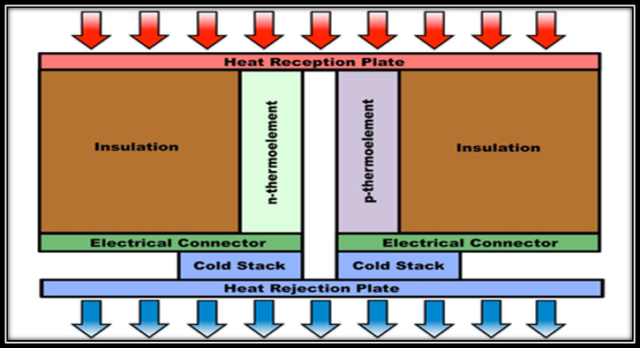
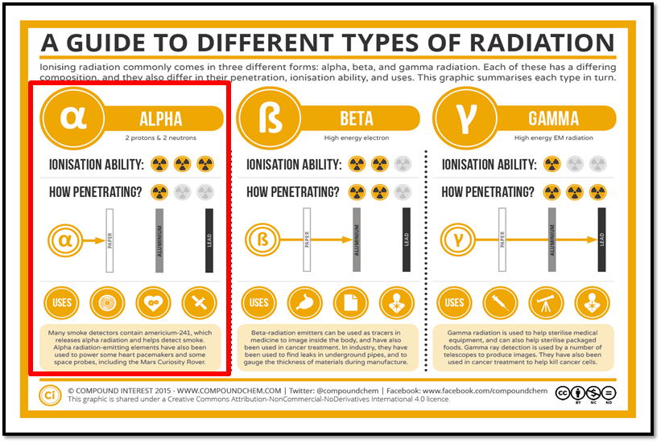
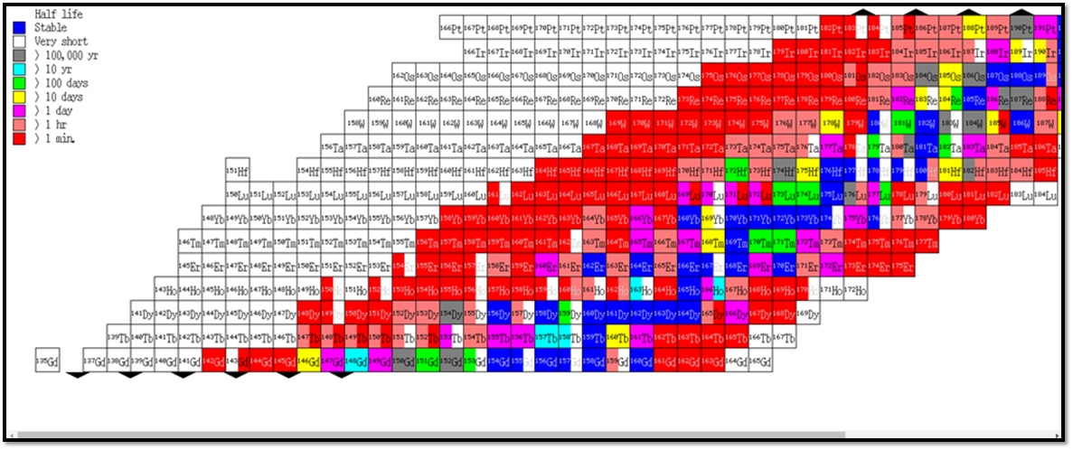
How Thermocouple Works
“A Guide to the Different Types of Radiation.” Compound Interest, 10 Sept. 2015, www.compoundchem.com/2015/09/10/radiation/.
“Application of Silicon-Germanium Thermoelectrics in Space Exploration.” Wikiwand, www.wikiwand.com/en/Application_of_silicon
germanium_thermoelectrics_in_space_exploration
An isotope that is an alpha emitter will be chosen.
The cold environment (cold Junction) and the heat from the decay heat (heat Junction) will bd used to develop a voltage difference.

Slide 18
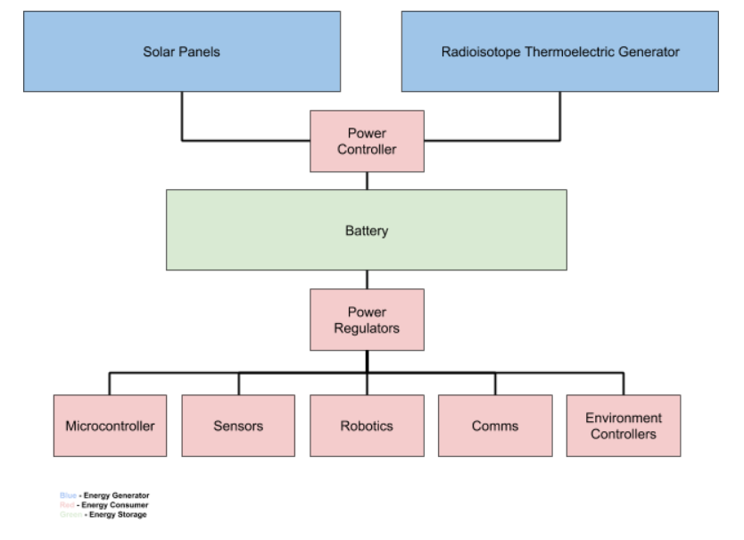
Power Distribution
There will be multiple input sources to charge main batteries and maintain the system running
The power sources will compensate for each other’s limitations. To produce the highest success rate of the Mars mission.
All devices will draw from the power sources directly which means batteries will only be used in emergencies.
Controllers and regulators will handle power loss.
The power efficiency will be calculated from all these factors.
Notes:
Sky added this slide let me know any issues or comments

Slide 19
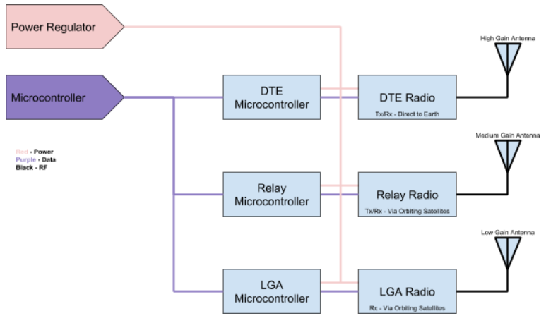
Communication
Multiple radios will be used for redundant communication in case of failure.
Separate microcontrollers will be used to prevent single point of failure.
For Earth Mars communication antennas will be used.
Notes:
Sky added this slide let me know any issues or comments

Slide 20
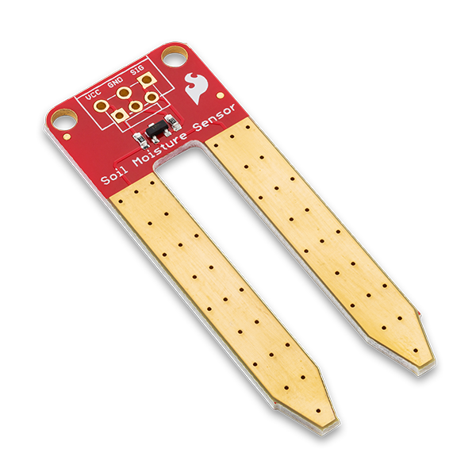
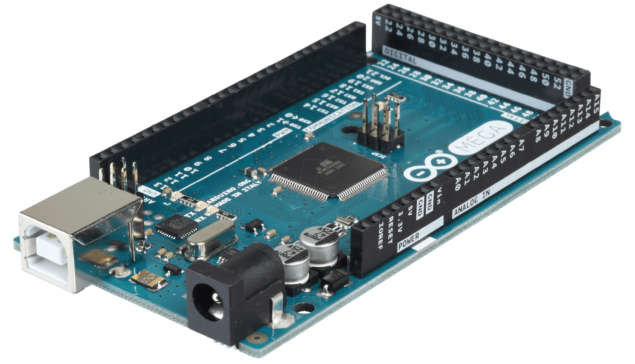
System Automation
To automate the system an Arduino micro controller will be set up to collect, manipulate, and store data. This data will be used to make changes depending on the moisture levels, temperature, and humidity.
The Arduino is connected to:
16 different moisture sensors
A temperature and humidity sensor (DHT22)
ESP8266
Camera
2x16 LCD Display
Micro SD card
other miscellaneous sensors
The ESP8266 transmits data to a wireless network and the plants can be monitored live.

Slide 21
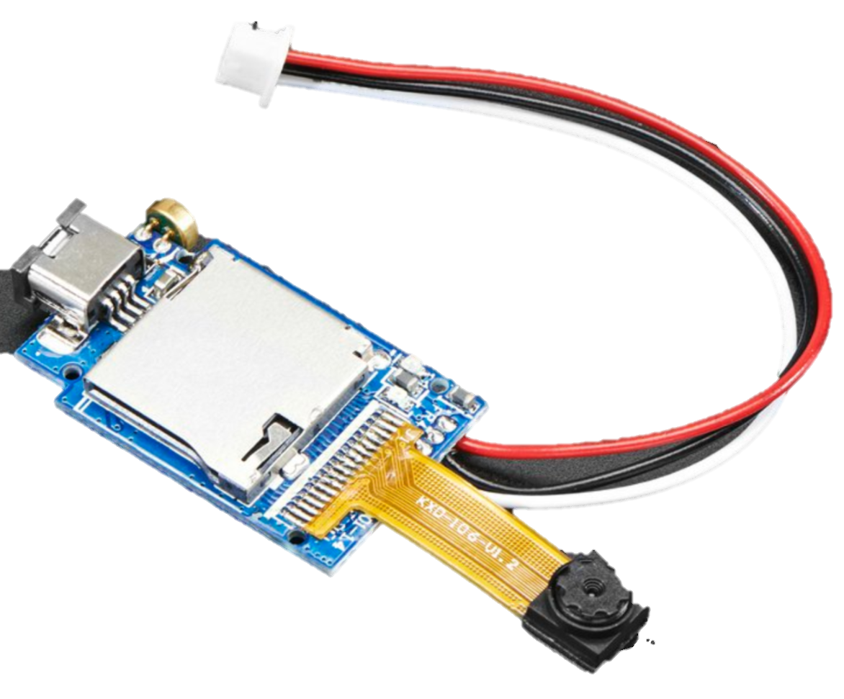
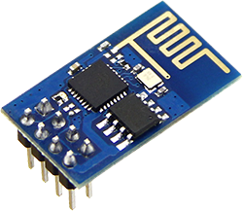
Automated Watering and Control System
In a theoretical level, the ideal thing to do is to change the amount of water going in the system based on the readings the moisture sensors give out. This increases its efficiency and simplicity.
ESP8266 wireless module

Slide 22
Theoretical Space Garden Materials
The most effective designs for maximum efficiency can be achieved in multiple ways:
Enclosed growth environment (no sun/plant contact)
Clear coat growth environment (use of Mars sun on plants)

Slide 23
Enclosed Growth
Will employ polymer aerogels to insulate and protect the growth environment.
Light will be produced by UV grow lights.
This environment will consume more power but will allow for a more accurate and controlled growth environment for the plants.

Slide 24

Growth Environment
Sustaining an Artificial Environment

Slide 25
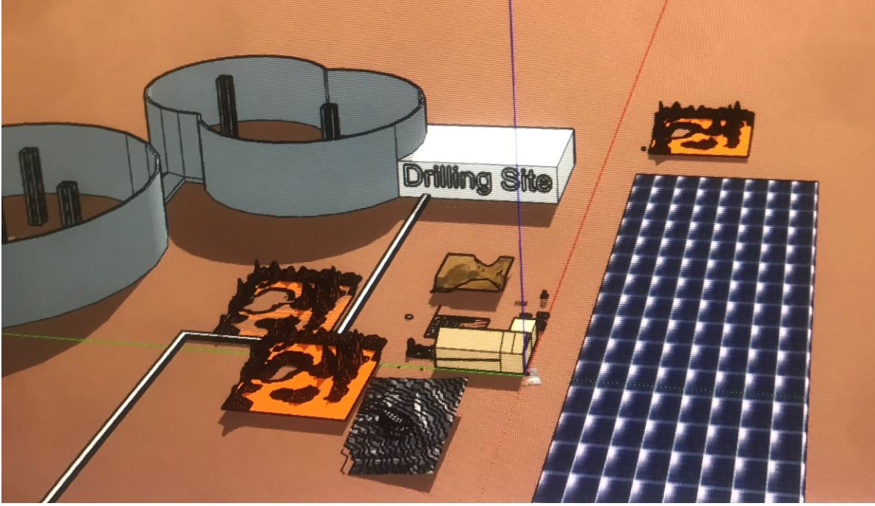
Geological Analysis
We will be looking at the analysis of:
Composition on, below and above the regolith.
Nature of water on or below the regolith
Nature of perchlorates on or below the regolith
Extraction process for water and perchlorates
Purification process for water

Slide 26
Vegetation
The parameters taken into account for the growth environment:
Types of vegetation used for the prototype
Types of vegetation used for the theoretical model
Guide lines to be pick the fittest candidates:
Minimum requirements for vegetarian diet
Fast growth rate
High plant, biofuel, and food yields
Easiest refinement process for biofuels
Amount of solar energy needed for effective growth
Soil requirements for effective growth

Slide 27
Biodiesel and Food Candidates
The eligible candidates for biodiesel:
Soybean oil: soy biodiesel is cleaner burning than petroleum- based diesel oil, it is non-toxic, reduces particle emissions, renewable, and environmentally friendly. Soy based lubricants work equally as well as petroleum based lubricants, but are able to withstand higher heats
Corn oil: high starch content and easy conversion to ethanol make corn grain an excellent candidate for biofuel use
Potatoes: potato peelings can be liquified and fermented to produce fuel grade ethanol.
Algae: has a rapid growth rate and can produce biofuel for rockets.

Slide 28
Biodiesel and Food Candidates (cont.)
The eligible candidates for sustenance:
Potatoes: ethanol production, potato starch as a biodegradable substitute for polystyrene and plastic, use for animal feed, can be used as a food binding agent, seed tubes can be reused for replanting.
Soybeans: protein substitute, high yield healthy cooking oil (60% polyunsaturated fat/ 24% monounsaturated fat), remaining high-protein fiber after oil press can be used for animal feed, transesterification of oil to produce biofuels, and used for biocomposites that replace products commonly made by wood.
Corn: rich source of vitamins and minerals, animal feed, ethanol production, protects body against diabetes, cancer and promotes eye health, produces steep liquor medium for penicillin growth, used for biofuel.

Slide 29
Biodiesel and Food Candidates (cont.)
The eligible candidates for biodiesel:
Soybean oil: soy biodiesel is cleaner burning than petroleum- based diesel oil, it is non-toxic, reduces particle emissions, renewable, and environmentally friendly. Soy based lubricants work equally as well as petroleum based lubricants, but are able to withstand higher heats
Corn oil: high starch content and easy conversion to ethanol make corn grain an excellent candidate for biofuel use
Potatoes: potato peelings can be liquified and fermented to produce fuel grade ethanol.
Algae: rapid growth and can produce biofuel for rockets.

Slide 30
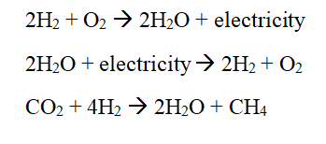
Carbon Dioxide Atmospheric Absorption
To absorb carbon dioxide from the atmosphere:
The Sabatier Reaction can use the excess hydrogen alongside atmospheric carbon dioxide to produce water for the crew/greenhouse crops.
The methane from this reaction can either be vented into the atmosphere, or can be used as rocket propellent.

Slide 31
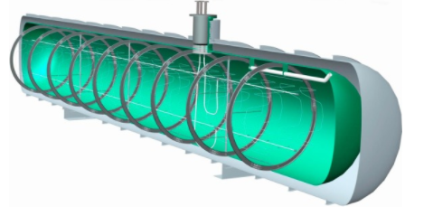
Essential Gasses Storage
Hydrogen and oxygen storage are both implemented with the thought that the water on Mars will be accessible.
Hydrogen, oxygen and nitrogen must be converted from the gas to liquid phase. These cryogenic liquids can be stored in a tube-in-tank storage unit, which should minimize the gas lost from the boil-off effect.
If water is accessible on Mars, hydrogen and oxygen
can be produced via the Sabatier Reaction.
Nitrogen can be obtained with argon by taking in
compressed atmosphere and selectively filtering
them to a cooling system.

Slide 32
Design Constraints and Challenges
Prototype limitation
Time limitations
High amount of people in the team
Content management
Wait time on controllers
Component additions to the original prototype design
Material studies for the theoretical growth environment

Slide 33



Acknowledgements
Dr. Martz, Dr. Moreno, and Dr.Tzouanas Department of Natural Sciences UHD
NASA Glenn Research Center
Houston PREP

